Slide 1

Application of Stack: Prefix and Postfix Expressions Evaluation of postfix expression
Data Structure | ADT: Stack and Queue
Course: Data Structure | Chapter: ADT: Stack and Queue | Program: Bachelor of Engineering
DISCOVER · LEARN · EMPOWER
Notes:
Welcome everyone to today's lecture on Data Structures. We are focusing on the practical applications of the Stack Abstract Data Type. Specifically, we will explore how stacks solve the problem of evaluating mathematical expressions in prefix and postfix formats. This is a crucial skill for compiler design and expression parsing.

Slide 2
Course Outcomes
SLIDE 2 / 10
Course Outcome
CO | BT LEVEL | DESCRIPTION
CO1 | BT1 | Understand and apply basic data structures, algorithms, complexity analysis, ADTs, arrays and linked lists.
CO2 | BT2 | Apply and implement stacks and queues in problem-solving.
CO3 | BT3 | Analyse and apply searching, sorting, and hashing techniques.
CO4 | BT4 | Construct and apply tree structures and traversal techniques.
CO5 | BT5 | Represent and solve graph problems using DFS, BFS, and graph algorithms.
Chandigarh University
2 / 10
Notes:
Today's session directly supports our Course Outcomes. CO3 requires us to analyse and apply searching, sorting, and hashing techniques, which includes expression evaluation algorithms. CO4 focuses on constructing and applying tree structures and traversal techniques, as expression trees are a primary application of stacks. Understanding these outcomes helps you see the bigger picture of data structure applications.

Slide 3
Learning Objectives
SLIDE 3 / 10
Learning Outcomes
1
Define the structure and rules of Prefix and Postfix notations.
2
Analyze the step-by-step algorithm for evaluating Postfix expressions.
3
Demonstrate the evaluation process using a concrete numerical example.
4
Compare the efficiency of Postfix evaluation against standard Infix notation.
Chandigarh University
3 / 10
Notes:
By the end of this lecture, you will be able to define the specific rules that govern Prefix and Postfix notations. You will analyze the stack-based algorithm used to evaluate these expressions without ambiguity. We will demonstrate this by walking through a specific numerical example together. Finally, we will compare why Postfix is often more efficient for computers than standard Infix notation.

Slide 4
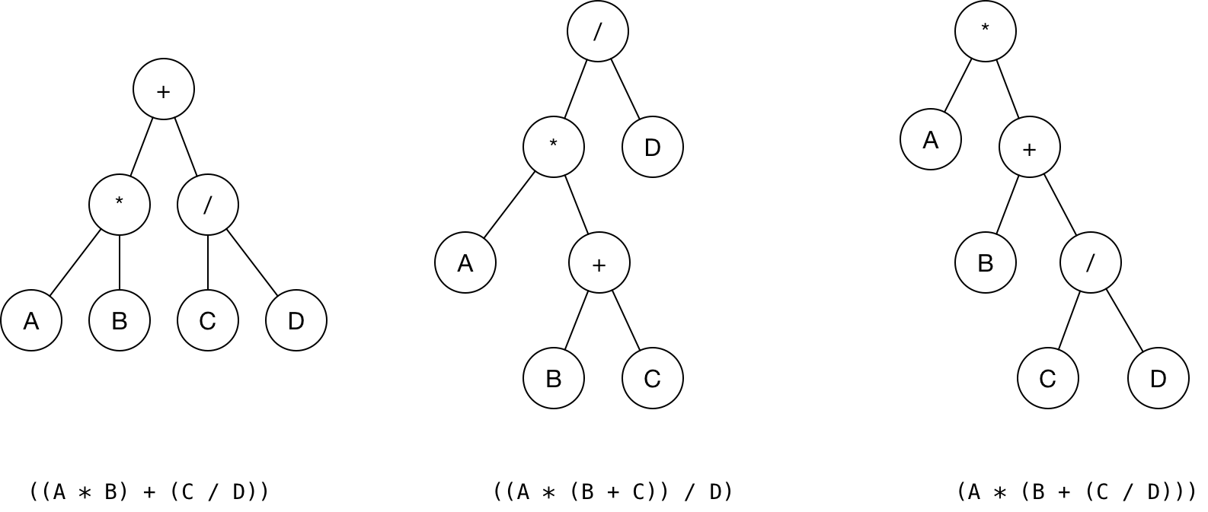
Lecture
SLIDE 4 / 10
Infix vs Postfix Notation Rules
1
Infix notation places operators between operands like A + B.
2
Postfix notation places operators after operands like A B +.
3
Prefix notation places operators before operands like + A B.
4
Postfix eliminates the need for parentheses and operator precedence rules.
5
Stacks are the ideal data structure for converting and evaluating these forms.
Infix, Postfix and Prefix
Chandigarh University
4 / 10
Notes:
Standard math uses Infix notation where operators sit between numbers, requiring parentheses for order. Postfix notation moves the operator to the end, removing the need for parentheses entirely. For example, the Infix expression (A + B) × C becomes A B + C × in Postfix. This structural change allows for a linear, left-to-right evaluation using a stack.

Slide 5
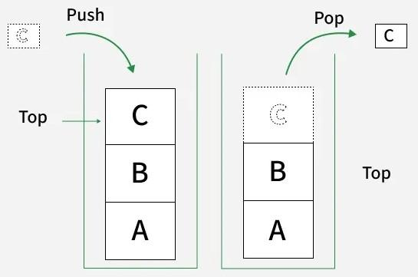
Lecture
SLIDE 5 / 10
Algorithm for Postfix Evaluation
1
Scan the Postfix expression from left to right character by character.
2
Push numeric operands directly onto the stack as they are encountered.
3
When an operator is found, pop the top two elements from the stack.
4
Perform the operation using the popped values and push the result back.
5
The final value remaining on the stack is the evaluated result.
Source: media.geeksforgeeks.org
Chandigarh University
5 / 10
Notes:
The algorithm is straightforward and relies on a single pass through the expression. We push numbers onto the stack until we hit an operator. At that point, we pop the last two numbers, perform the calculation, and push the result back. This process repeats until the entire string is processed. The single value left at the end is your answer.

Slide 6
Worked Example
SLIDE 6 / 10
5 3 + 2 *
GOVERNING EQUATION
Read +: Pop 3 and 5, calculate 5 + 3 = 8, push 8. Stack: [8]
1
Read 5: Push 5 onto the stack. Stack state: [5].
2
Read 3: Push 3 onto the stack. Stack state: [5, 3].
3
Read 2: Push 2 onto the stack. Stack state: [8, 2].
4
Read *: Pop 2 and 8, calculate 8 × 2 = 16, push 16. Result: 16.
Chandigarh University
6 / 10
Notes:
Let's trace the expression 5 3 + 2 × together. First, we push 5 and 3. When we see the plus sign, we add them to get 8. Next, we push 2. Finally, the multiplication sign tells us to multiply the 8 and the 2. The final result is 16. This example shows how the stack handles the order of operations automatically.

Slide 7
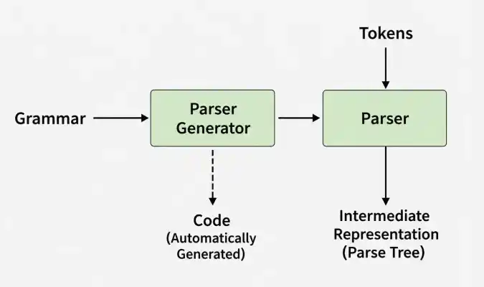
Lecture
SLIDE 7 / 10
Handling Multi-Digit Operands
1
The algorithm must distinguish between single digits and multi-digit numbers.
2
Use a delimiter like a space to separate operands and operators clearly.
3
Accumulate digits to form a complete number before pushing to the stack.
4
Failure to parse multi-digit numbers leads to incorrect evaluation results.
5
Standard input usually includes spaces between every token for clarity.
Source: media.geeksforgeeks.org
Chandigarh University
7 / 10
Notes:
In real-world applications, operands are rarely single digits. We must handle multi-digit numbers like 12 or 100. The key is to use spaces as delimiters to separate tokens. If we encounter a digit, we accumulate it to form the full number before pushing it. Without this logic, the algorithm might treat '12' as '1' and '2' separately, causing errors.

Slide 8
Lecture
SLIDE 8 / 10
Why Postfix is Efficient for Computers
1
Postfix evaluation requires only one pass through the expression string.
2
No recursive calls or complex precedence checking is needed during evaluation.
3
The stack naturally handles the order of operations without extra logic.
4
This linear time complexity O(n) makes it ideal for compiler back-ends.
5
It simplifies the hardware design for expression evaluation units.
Chandigarh University
8 / 10
Notes:
Why do we bother with Postfix? It is significantly more efficient for computers. Unlike Infix, which requires checking operator precedence and parentheses, Postfix evaluation is a simple linear scan. This reduces the time complexity to O(n), making it perfect for compiler design. It simplifies the hardware logic required to evaluate mathematical expressions in real-time.

Slide 9
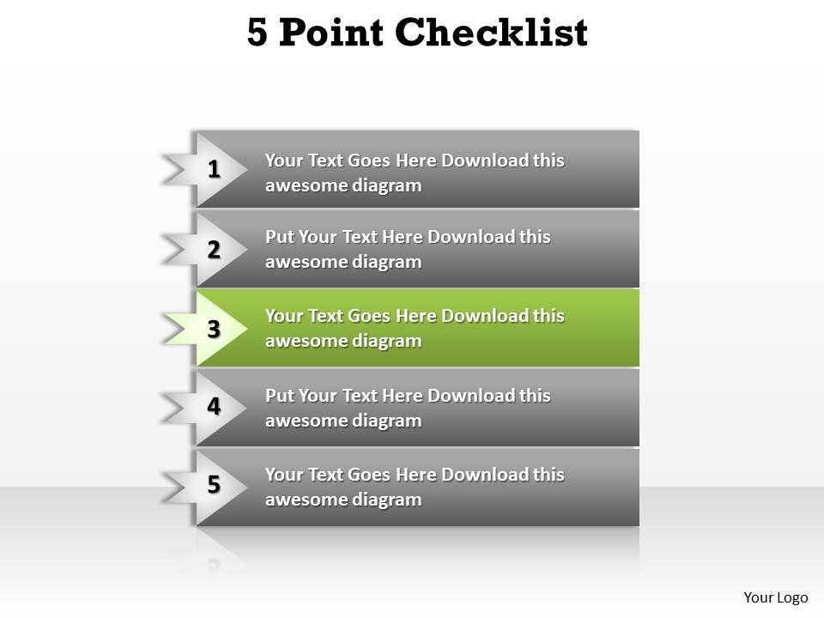
Lecture
SLIDE 9 / 10
Key Takeaways
1
Postfix notation places operators after operands, eliminating the need for parentheses.
2
Stacks are the fundamental data structure used to evaluate Postfix expressions.
3
The evaluation algorithm pushes operands and performs operations upon encountering operators.
4
Postfix evaluation is a linear O(n) process ideal for computer implementation.
5
Proper parsing of multi-digit operands is essential for correct results.
Source: www.slideteam.net
Chandigarh University
9 / 10
Notes:
To summarize, Postfix notation simplifies expression evaluation by removing parentheses and precedence rules. We use a stack to process operands and operators in a single left-to-right pass. This method is efficient and forms the basis for how compilers evaluate code. Remember that handling multi-digit numbers correctly is a critical implementation detail.

Slide 10
Lecture
SLIDE 10 / 10
References
DATA STRUCTURES
A Pseudocode Approach with C — Gilberg, Forouzan
• Data Structures — Lipschutz
• Data Structure Using C — AK Sharma
• C and Data structure — P. S. Deshpandey
Chandigarh University
10 / 10
Notes:
For further reading and deeper understanding of these concepts, please refer to the listed textbooks. Gilberg and Forouzan provide excellent pseudocode approaches for these algorithms. Lipschutz and Sharma offer comprehensive coverage of C implementations. Deshpandey also provides valuable insights into data structures using C. Thank you for your attention.

